Slide 1
What is object orientation?
Object-oriented programming, is a problem-solving method in which the software solution reflects objects in the real world.
Key Features
Instantiation
Encapsulation & Abstraction
Inheritance
Polymorphism
Interfaces
Reduction in code redundancy
Stress on data security and access

Slide 2
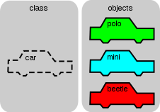
Overview- Object Oriented Programming
What are objects and classes ?
Objects
An object is a section of source code that contains data (attributes) and provides services (via methods). They help programmers to map a real problem and its proposed software solution on one-to-one basis.
Classes
Classes describe objects i.e objects are run time instances of classes. Each instance (object) of a class has a unique identity and its own set of values for its attributes

Slide 3
Defining Class
A class is a set of objects that have the same structure and same behavior. A class is therefore like a blueprint, in accordance with which all objects in that class are created.
The class statement can’t be nested i.e you can’t define a class within a class.
The components of the class are defined in the definition part.
The components are attributes, methods, events, constants, types and implemented interfaces.
Only methods are implemented in the implementation part.

Slide 4
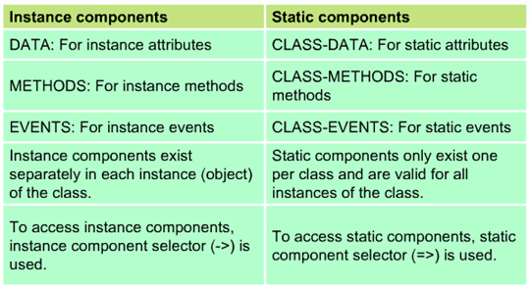
Components of classes
There are two main components of classes: Instance and Static components.

Slide 5
Attributes
Attributes describe the data that can be stored in the objects of a class.

Slide 6
Attributes
In classes, you can only use the TYPE addition to refer to data types.
The READ-ONLY addition means that a public attribute declared with DATA can be read from outside, but can only be changed by methods of the class.
Currently, you can use the READ-ONLY addition only in public visibility section (PUBLIC SECTION) of a class declaration or in an interface definition.

Slide 7
Attributes and Visibility

Slide 8
Accessing private attributes
You can access an object’s private attributes using public methods, which in turn output these attributes or change it.

Slide 9
Instance attributes and Static attributes

Slide 10
Methods
Methods are internal procedures in classes that determine the behavior of an object. They can access all attributes in their class and therefore change the state of an object.
Methods have a parameter interface (called signature) that enables them to receive values when they are called and pass values back to the calling program.
Methods are of two types: Standard Methods & Event Handler Methods.
Methods are called with a CALL METHOD statement.

Slide 11
Methods and Visibility

Slide 12
Instance method and Static method
Static Methods can not be redefined and this violates the most important rule of OOPs. It is primarily because static methods can be called on their own without any instance of the class

Slide 13
Creating Objects
An object is a section of source code that contains data and provides services.

Slide 14
Creating Objects: Syntax
The CREATE OBJECT statement creates an object in main memory. The attributes values of this object are either initial values or correspond to VALUE entry.
Reference variables can also be assigned to each other.
For the above example this would mean that r_vehicle1 & r_vehicle2 point to the same object.

Slide 15
Garbage Collector
As soon as no more references point to an object, the Garbage collector removes it from the memory. The garbage collector is a system routine that automatically deletes objects that can no longer be addressed from the main memory and releases the memory space they occupied.

Slide 16
Accessing Attributes and Methods
Instance methods are called using CALL METHOD <reference>-><instance_method>.
Static methods (also referred to as class methods) are called using CALL METHOD <classname>=><class_method>.
If you are calling a static method from within the class, you can omit the class name.
You access static attributes using <classname>=><class_attribute>.
You access instance attributes using <instance>-><instance_attribute>.
=> and -> are the component selectors

Slide 17
Functional Method
Methods that have a RETURNING parameter are described as functional methods. These methods cannot have EXPORTING or CHANGING parameters, but has many (or as few) IMPORTING parameters and exceptions as required. You can only do this for a single parameter, which additionally must be passed as a value.

Slide 18
Constructor
The constructor is a special method in a class with the name constructor.
Used for initializing- data structure/ state of an object, set default values that require calculation.
Each class can have one constructor.
The constructor is automatically called at runtime within the CREATE OBJECT statement.
If you need to implement the constructor, then you must define and implement it in the PUBLIC SECTION.
You cannot normally call the constructor explicitly.

Slide 19
Instance Constructor
Special instance method in a class that is always named CONSTRUCTOR.
Automatically called at runtime with CREATE OBJECT statement.
Can be used to initialize the object.
Must be defined in the PUBLIC section.
The constructor’s signature can have only importing parameter and exceptions ( no exporting parameters).
When exceptions are raised in constructor, instances are not created so no main memory is occupied.

Slide 20
Static Constructor
The static constructor is a special static method in a class with the name CLASS_CONSTRUCTOR.
It is executed precisely once per program ( while loading class into memory).
Each class can have only one static constructor.
Must be defined in PUBLIC Section.
Constructor’s signature can’t have importing parameters or exceptions.
Static constructor can not be called explicitly.
The static constructor of a class <classname> is called automatically before the class is first accessed, and helpful in initializing global values that might be needed across the instances. but before any of the following actions are executed:
Creating an instance in the class using CREATE OBJECT <obj>, where <obj> has the data type REF TO <classname>
Addressing a static attribute using <classname>=><attribute>
Calling a static attribute using CALL METHOD <classname>=><classmethod>
Registering a static event handler method using SET HANDLER <classname>=><handler_method> FOR <obj>
Registering an event handler method for a static event in class <classname>.

Slide 21
Reference variable ME
You can address the object itself within instance methods using the implicitly available reference variable ME.
Description of Example:
In the constructor, the instance attribute ‘make’ is covered by the locally defined variable ‘make’ . In order to still be able to address the instance attribute, you need to use “ME” variable. Within the implementation of every instance method, an implicitly created local reference variable called me is available, which points to the instance in which the method is currently being executed.

Slide 22
Inheritance
Inheritance is a relationship, in which one class (the subclass) inherits all the main characteristics of another class (the super class). The subclass can also add new components (attributes, methods, and so on) and replace inherited methods with its own implementations.
The inheritance relationship is often described as an “is a” relationship: a truck is a vehicle.

Slide 23
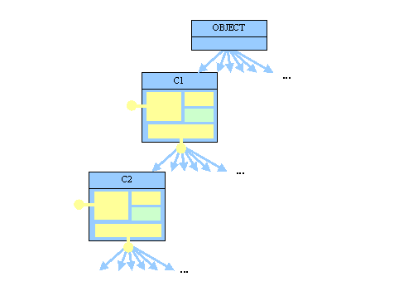
Single Inheritance
ABAP Objects only have single inheritance.
A class may only have one direct super class, but it can have more than one direct subclass. The empty class OBJECT is the root node of every inheritance tree in ABAP Objects.

Slide 24
Relationship between Super class and Sub class

Slide 25
Redefining Methods
The REDEFINITION statement for the inherited method must be in the same SECTION as the definition of the original method.
If you redefine a method, you do not need to enter its interface again in the subclass, but only the name of the method.
In the case of redefined methods, changing the interface (overloading) is not permitted; exception overloading is possible with the help of constructor.
Within the redefined method, you can access components of the direct superclass using the SUPER reference.
The pseudo-reference SUPER can only be used in redefined methods.

Slide 26
Redefining Methods contd…

Slide 27
Inheritance: Syntax
Normally the only other entry required for subclasses is what has changed in relation to the direct superclass. Only additions are permitted in ABAP Objects, that is, in a subclass you can "never take something away from a superclass". All components from the superclass are automatically present in the subclass.

Slide 28
Inheritance and Visibility
Inheritance provides an extension of the visibility concept: There are protected components. The visibility of these components lies between that of the public components and private. Protected components are visible to and can be used by all subclasses and the class itself.
In ABAP Objects, you must keep to the section sequence -> PUBLIC, PROTECTED, PRIVATE

Slide 29
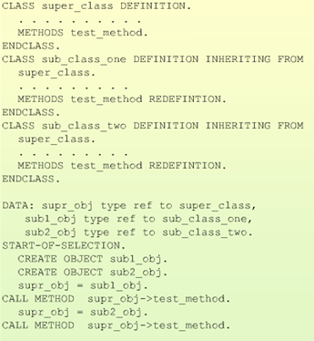
Inheritance: Polymorphism
Polymorphism means using the same name throughout the interface to address differently implemented methods, belonging to different objects of different classes in the inheritance tree.

Slide 30
Casting
Narrowing Cast
The assignment of a subclass instance to a reference variable of the type "reference to superclass" is described as a narrowing cast, because you are switching from a more detailed view to a one with less detail.
Description up-cast is also used.
What is a narrowing cast used for?
A user who is not interested in the finer points of cars, trucks, and busses (but only, for example, in the fuel consumption and tank gauge) does not need to know about them. This user only wants and needs to work with (references to) the lcl_vehicle class. However, in order to allow the user to work with cars, busses, or trucks, you generally need a narrowing cast.

Slide 31
Narrowing Cast

Slide 32
Widening Cast
The widening cast logically represents the opposite of the narrowing cast. The widening cast cannot be checked statically, only at runtime. The Cast Operator ?= (or the equivalent MOVE ... ?TO … ) must be used to make this visible.
It changes from a less detailed view to one with more detail.
What is a widening case used for?
The client, the car rental company wants to execute a function for specific vehicles form the list (vehicle_list). For example, the client wants to ascertain the truck with the largest cargo capacity. However, not all vehicles are in the trucks list, it also includes references to cars and busses.

Slide 33
Widening Cast contd…
With this kind of cast, a check is carried out at runtime to ensure that the current content of the source variable corresponds to the type requirements of the target variables.
If it is, the assignment is carried out. Otherwise, an exception of the error class CX_SY_MOVE_CAST_ERROR is raised.

Slide 34
Interfaces
Interfaces only describe the external point of contact of a class (protocols), they do not contain any implementation.
Interfaces are usually defined by a user. The user describes in the interface which services (technical and semantic) it needs in order to carry out a task.
The user never actually knows the providers of these services, but communicates with them through the interface.
In this way the user is protected from actual implementations and can work in the same way with different classes/objects, as long as they provide the services required. This is known as polymorphism with interfaces.

Slide 35
Interfaces features

Slide 36
Defining and implementing interface

Slide 37
Working with interface components
You can access interface components using an object reference, whose class implements the interface. Syntactically this is done with the interface resolution operator, just as with the method definitions in the implementation part of the class.

Slide 38
Compound interface
A compound interface contains other interfaces as components (component interfaces) and summarizes the extension of these component interfaces.

Slide 39
Compound Interface example

Slide 40
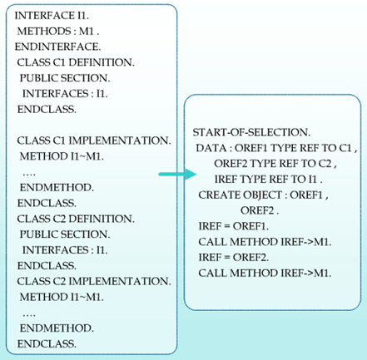
Interfaces: Polymorphism
Interfaces allow to use different classes in a uniform way using interface references.
The identical interface reference variable operates on multiple objects that implement the interface.

Slide 41
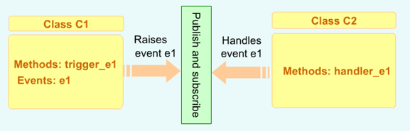
Events
In ABAP Objects, events use the publish-and-subscribe approach.
A class declares an event and implements a method to raise (publish) the event.
The same or other classes implement a method to respond (subscribe) to the event.
At run time, interested classes and objects register their wish and availability to respond.

Slide 42
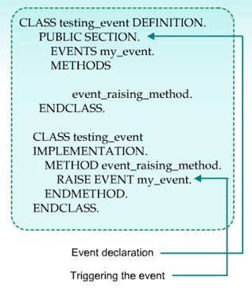
Defining and triggering events
Features of events:
can be declared as public, protected or
private components of any class or interface
can be static or instance
Can be triggered by any method in the class
using RAISE EVENT statement.
Parameter interface for events is limited to
exporting parameters, passed by VALUE.
Doesn’t have implementation part.

Slide 43
Handling Events
Event handler methods use the FOR EVENT (event name) OF {CLASS (class name) | INTERFACE (interface name)} addition
Classes or their instances that receive a message when an event is triggered at runtime and want to react to this event define event handler methods. Statement:
[CLASS-]METHODS <handler_method> FOR EVENT <event> OF <classname>.
These classes or their instances are registered to one or more events at runtime. Statement:
SET HANDLER <handler_method> FOR <reference>. (for instance events) SET HANDLER <handler_method>. (for static events)
Methods are only executed when the event associated with these methods are triggered.

Slide 44
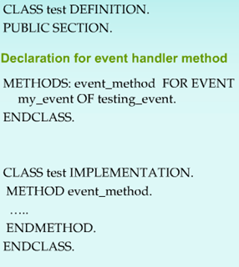
Handling Events contd…

Slide 45
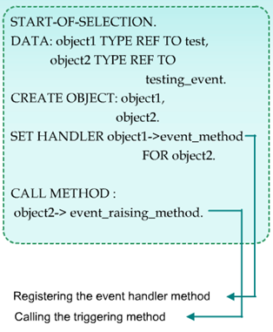
Registering Events
To automatically execute the event handler method when the event is raised, the handler method has to be registered.
The key statement SET HANDLER can register the handler method.

Slide 46
Local Classes and Interfaces
Local classes and interfaces are only known within the program in which they are defined and implemented.
Local classes and interfaces are not stored in the Repository (no TADIR entry). There is no "global" access to these classes or interfaces (for example, from other programs).

Slide 47

Global Classes and Interfaces
What are global classes and interfaces?
Global classes and interfaces are created and
stored in a class pool and interface pool such
as function pool (function group).
Global classes and interfaces are managed centrally and available to every program.
Custom global classes and interfaces must begin
with Y* or Z*.
Global and local classes and interfaces have the
same components and there is no difference in
how they are used within programs.

Slide 48
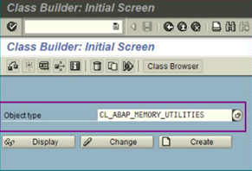
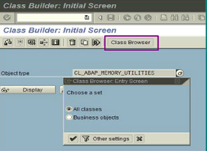
Global classes and interfaces contd…
Global classes and interfaces are maintained
through transaction SE24 or SE80
Use class browser to view global classes
and interfaces in the repository.

Slide 49
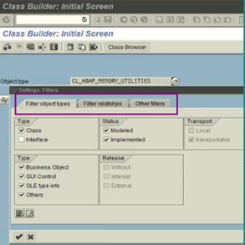
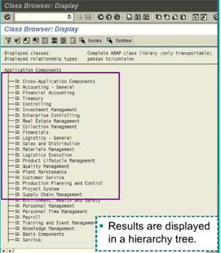
Global classes and interfaces contd…
Set class browser filters to select by object
type, by relationship and so on.
Results are displayed in a hierarchy tree.

Slide 50
Abstract Classes
Abstract classes are normally used as an incomplete blueprint for concrete (that is, non-abstract) subclasses, for example to define a uniform interface.
Classes with at least one abstract method are themselves abstract.
Static methods and constructors cannot be abstract.
You can specify the class of the instance to be created explicitly: CREATE OBJECT <RefToAbstractClass> TYPE <NonAbstractSubclassName>.

Slide 51
Final Classes
A final class cannot have subclasses, and can protect itself in this way against (uncontrolled) specialization.
A final method in a class cannot be redefined in a subclass, and can protect itself in this way against (uncontrolled) redefinition.
A final class implicitly only contains final methods. In this case, you cannot enter FINAL explicitly for these methods.
Methods cannot be both final and abstract.

Slide 52
Singleton Concept
If it is to be impossible to instantiate a class more than once (for example, because it serves as a data administrator or data container), you can use the singleton concept. The class is defined with the addition CREATE PRIVATE and FINAL and instantiated using its static constructor.

Slide 53

Friend Classes
In rare cases, classes have to work together so closely that they need access to their protected and private components. To avoid making these components available to all users, there is the concept of friendship between classes.
To do this you use the FRIENDS additions to the CLASS statement, in which all classes and interfaces that are to be provided friendship are listed
In principle, providing friendship is one-sided: A class providing friendship is not automatically a friend of its friends. If a class providing friendship wants to access the non-public components of a friend, this friend has to explicitly provide friendship to it.
Classes that inherit from friends and interfaces that contain a friend as a component interface also become friends. However, providing friendship, unlike the attribute of being a friend, is not inherited. A friend of a super class is therefore not automatically a friend of its subclasses.

Slide 54
Persistent Class
The Persistence Object Services can be considered as a logical layer between the ABAP program and the database. This POS (Persistent Object Services) allow you to save the attributes of objects with a unique identity, and then load them again when you need them.
The moment you create a Persistent Class, workbench also generates two additional classes:
ZCB_PERSIST_XYZ as the Base Class
ZCA_PERSIST_XYZ as the Agent Class or Actor Class, if the name of your class is Z*XYZ
- We need to know what data needs to be persistent in nature, This is achieved by creating a “Persistence Mapping” between the Objects and the correcponding database tables.
-The data in these persistent objects is still not persistent unless it encounters a COMMIT WORK statement.

Slide 55
Class based exception concept
Exceptions
Exception refers to a situation that arises while an ABAP program is being executed, where there is no point in continuing to run the program in the normal way.
Class-based exceptions are raised either using the ABAP statement RAISE EXCEPTION or by the ABAP runtime environment.
If a class-based exception occurs, the system interrupts the normal program flow and tries to navigate to a suitable handler. If it cannot find a handler, a runtime error occurs
The use of class-based exceptions is not limited to object-oriented contexts. Class-based exceptions can be raised and handled in all ABAP processing blocks.
Exception classes can be defined globally in Class Builder or locally in a program.
Names of global exception classes are prefixed with CX_ and exception classes created in customer system are prefixed with YCX_, ZCX_.

Slide 56
Exceptions Classes: Inheritance hierarchy contd…
CX_ROOT
All exception classes inherit the following instance methods from root class <CX_ROOT>
The <GET_SOURCE_POSITION> method returns the program name, include name (if relevant), and line number in the source code where the exception occurred.
The <GET_TEXT> method returns an exception text of a class in the form of a string.
All exception classes inherit the following instance attributes from <CX_ROOT>
TEXTID of type SOTR_CONC for a key for the OTR (Online Text Repository) or of type SCX_T100KEY for a key for the T100 database table, which defines the exception text. This is normally set by the constructor and evaluated with GET_TEXT
PREVIOUS of reference type CX_ROOT, which can contain a reference to a previous exception. This is normally set by the constructor.
KERNEL_ERRID: contains the name of the appropriate run time error if the exception was triggered from the kernel. If the exception was raised using RAISE EXCEPTION, this attribute is initial.

Slide 57
Exceptions Classes: Inheritance hierarchy contd…

Slide 58
Handling Exceptions

Slide 59
Handling Exceptions contd…
Whenever an exception is triggered, an exception object is created. This object would contain more information on the error condition.
The TRY block contains the application code that is to handle the exceptions.
If an exception occurs in the TRY block the system searches first for a CATCH statement (which will handle the exception) in the same TRY-ENDTRY structure and then step by step outwards in all the enclosing TRY-ENDTRY structures.
A CATCH block contains the exception handler that is executed if a specified exception has occurred in the TRY block in the same TRY-ENDTRY structure.
In some cases, the system cannot find a handler for an exception within a specific TRY-ENDTRY structure but the exception is handled in a surrounding TRY-ENDTRY structure or passed along to a calling program. If this occurs, a CLEANUP block is executed before leaving the TRY-ENDTRY structure.

Slide 60
Passing Exceptions along
To pass along an exception from a procedure, you generally use the RAISING addition when defining the procedure interface.
After RAISING, list the exception classes whose objects are to passed along.

Slide 61
Thank You!

